Slide 1
Integrating the Strategies for Water and Energy Operations
DOE Water and Energy Nexus

Slide 2
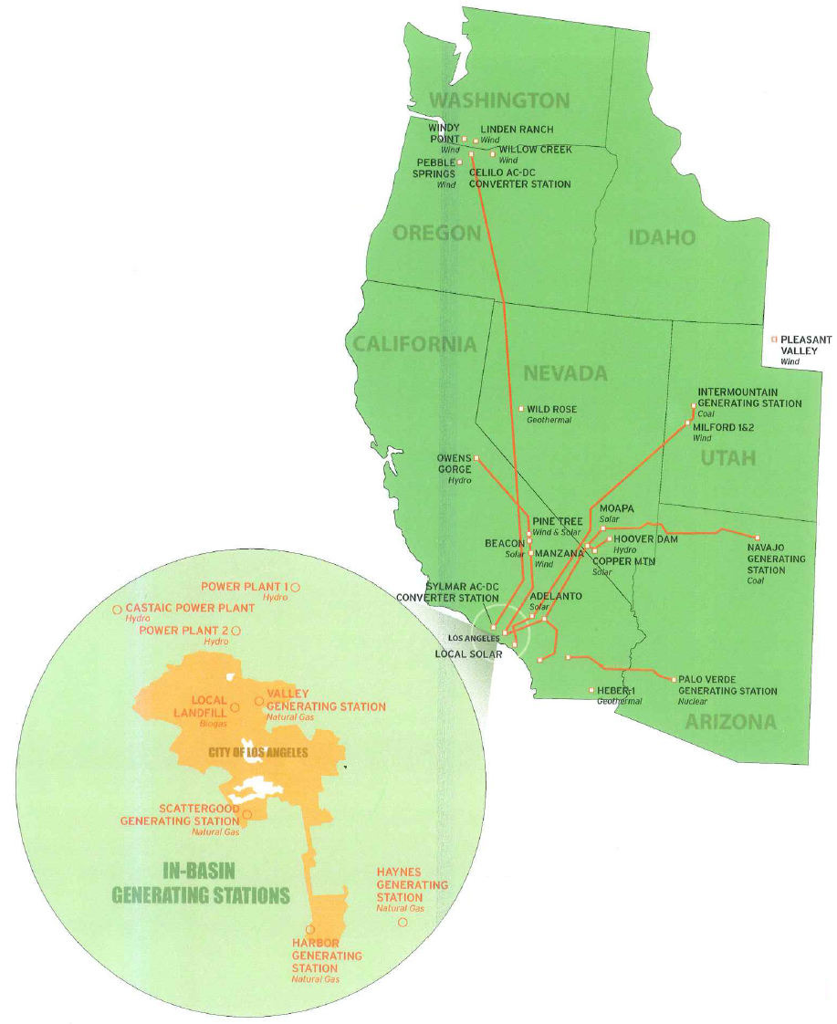
Power System Overview
Vertically-Integrated Utility
LADWP owns & operates its generation, transmission & distribution.
LA Basin and Owens Valley: customer load center
- 1.4 million customers
LA Basin Generation
Four large thermal
generating stations
Must import power from the
western grid into the LA Basin.

Slide 3
Water System Overview
Water flows by gravity 338 miles from the Mono Basin and 233 miles from the Owens Valley to Los Angeles through two Los Angeles Aqueducts
Balance of water (80% in 2014) is purchased from State Water Project of Colorado River or provided by local groundwater
There are eight storage reservoirs along the Los Angeles Aqueduct and 110 reservoirs and tanks within the City
Los Angeles uses about 215 billion gallons of water annually
The average LA resident uses about 155 gallons per day

Slide 4
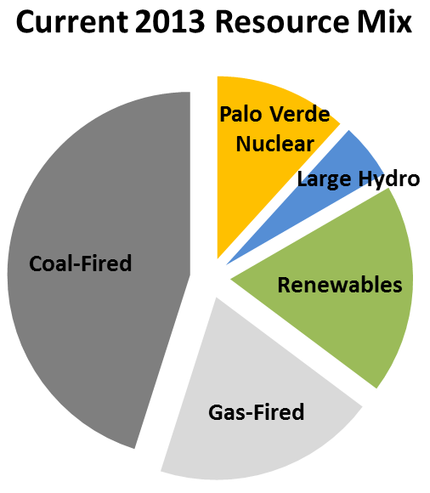
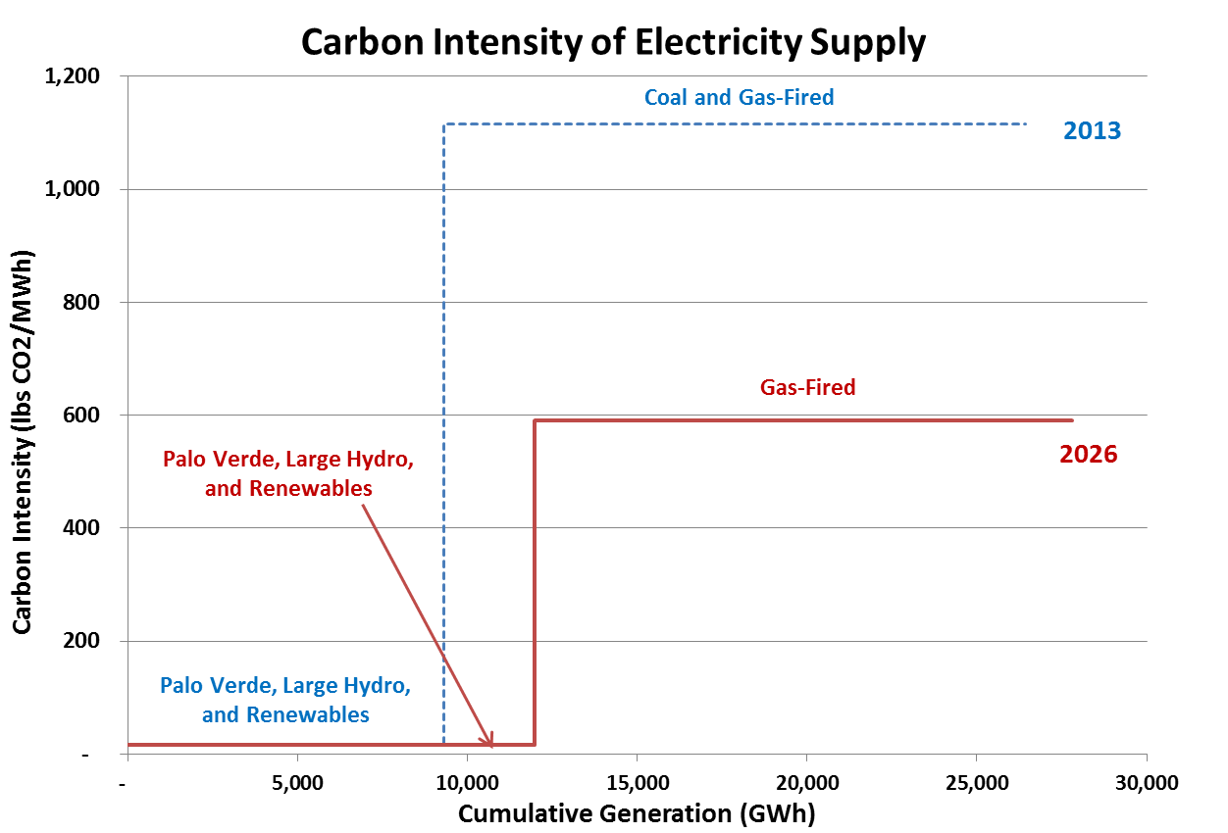
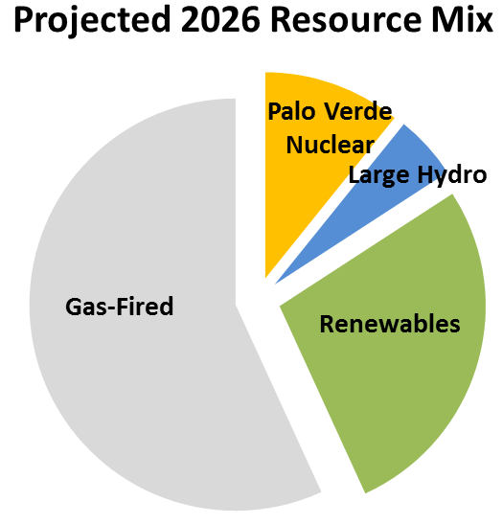
Resource Mix and Carbon Intensity of Supply
Nuclear, Large Hydro, and Renewables produce minimal carbon dioxide emissions.

Slide 5
Los Angeles’ Clean Energy Future
LADWP’s CO₂ emissions are 21% below 1990 level, and expected to be 55% below 1990 level by 2028.
2011 | 2012 | 2013 | 2014 | 2015 | 2016 | 2017 | 2018 | 2019 | 2020 | 2021 | 2022 | 2023 | 2024 | 2025 | 2026 | 2027 | 2028 | 2029 | 2030 | 2031 | 2032
2011 Level (14.2 MMT)

Slide 6
Water – Energy Nexus Operations
LADWP is making progress toward meeting goals & mandates, guided by long-term Integrated Planning between Water and Power Systems.
Dispatch coordination to optimize energy and capacity production and minimize impact for filtration and water delivery.
Implementing more cost effective approaches to integrate variable renewable energy using hydroelectric generation and pumping
High-level Solar Incentive Program participation for Water System facilities.
Coordinated energy efficiency and water conservation programs for customers
Share common right-of-ways
Water System using transmission right-of-ways for storm water capture basins.
Coordinated training and emergency response

Slide 7
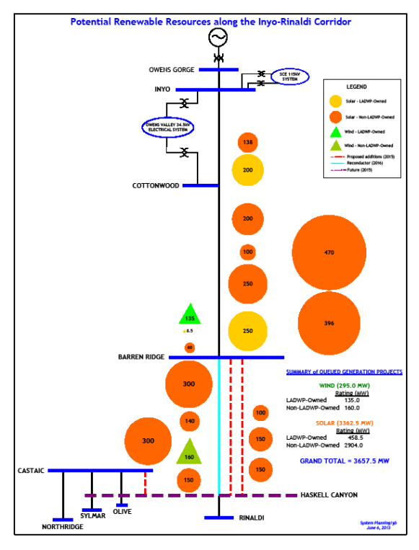
Owens Valley Transmission System

Slide 8
Water – Energy Nexus Policy and Planning
LADWP is making progress toward meeting goals & mandates, guided by long-term Integrated Planning between Water and Power Systems.
Facilitate and Increase Voluntary Water-Energy Partnerships - LADWP believes that more can be done to facilitate partnerships between water and energy (electricity and natural gas) utilities that will result in greater water and energy savings.
Enhance Voluntary Water-Energy Regional Data Collection - LADWP offers incentive programs for water-energy nexus projects. In a joint LADWP – UCLA Project, information is provided to customers about their usage comparisons with their neighbors. It has created strong savings results.
Support more Save Water & Energy Outreach Campaign to Customers - LADWP thinks this type of campaign is a good way to directly educate utility customers that saving water saves energy.
Develop more water conveyance storage jointly with energy production incorporated in the project

Slide 9
Water – Energy Nexus Remaining Challenges
LADWP is making progress toward meeting goals & mandates, guided by long-term Integrated Planning between Water and Power Systems.
Uncertainty with environmental regulations that impact water delivery and therefore energy production.
FERC Hydro Relicensing process continues to be a significant resource drain and people and dollars
Drought conditions create greater fuel price volatility and more recently emission credit pricing volatility.
More research and development is necessary to develop smaller scale pump storage technology.
More research and development is necessary to develop better dry cooling technology.

Slide 10
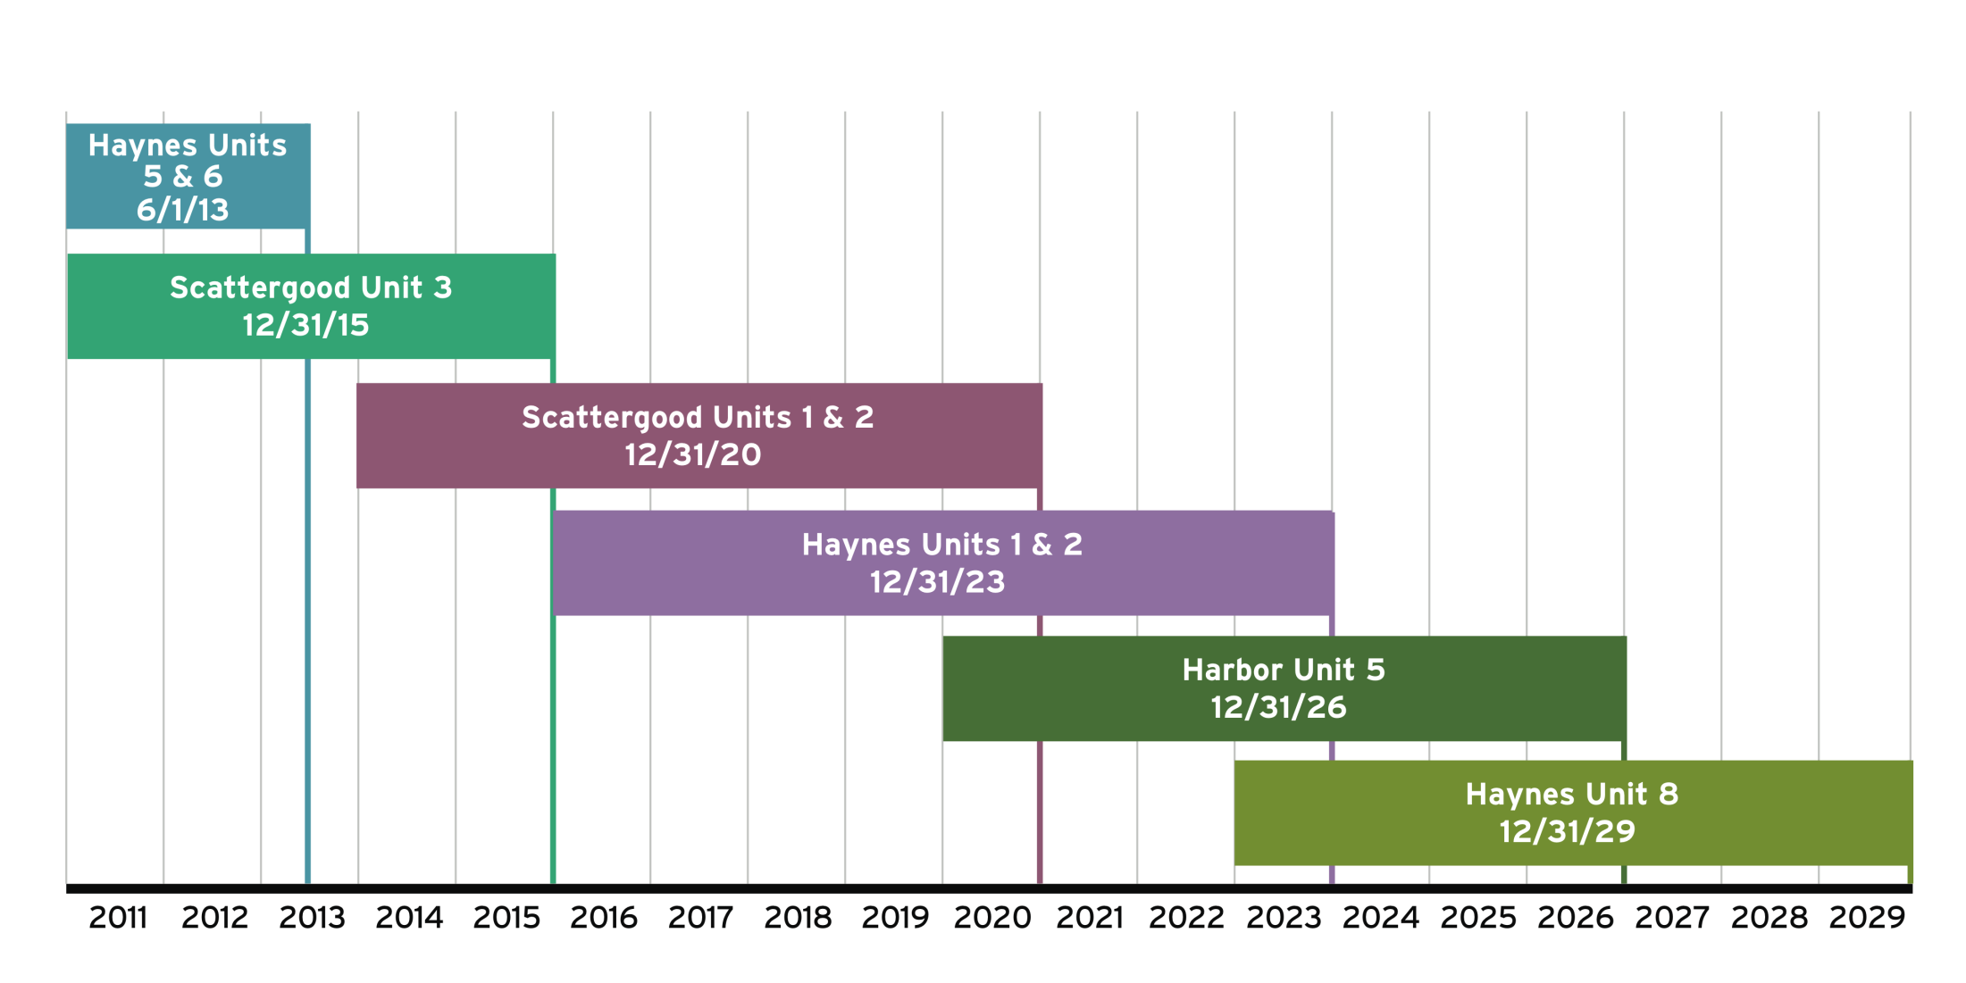
Road to Once Through-Cooling Compliance
LADWP must replace 9 generating units at 3 Coastal Power Plants. No unit can be taken off-line until its replacement is ready--like replacing the engine of a 747 while in mid-flight.
Completed - 6 units in service on June 2013 (600 MW)
Construction began - 3 units - Sept 2013 (508 MW)

